Slide 1

Sign Language Translator App
By: Mihika Nigam
Mentored By: Kavita Ma’am

Slide 2
Introduction
Sign Languages are a set of languages that use predefined actions and movements to convey a message. These languages are primarily developed to aid deaf and other verbally challenged people
This sign language recognition model aims towards analyzing and recognizing various alphabets from a test database of sign images.
In this project we will be trying to build a model to achieve an accuracy of 98% or more.

Slide 3
Objective
To design a model which will clearly classify the hand gesture to its corresponding sign language alphabet.
Giving this model a simple user-friendly interface.
Using the flutter application to show the predictions.

Slide 4
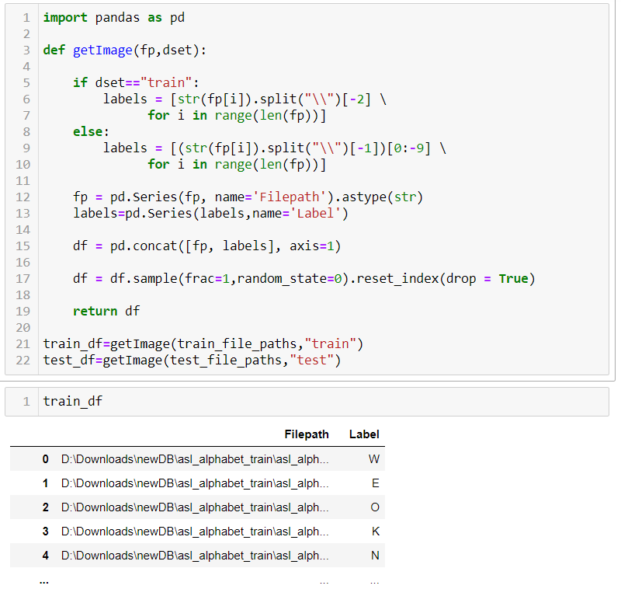
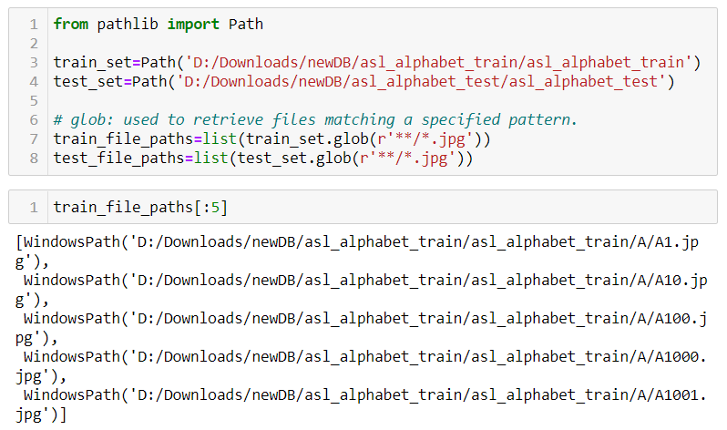
Methodology
Collecting Data
The dataset consists of 87000 images of hand gestures. The images belong to 29 classes : 26 alphabets and 3 extra classes(delete, space and nothing).
We created a dataframe of all the filepaths of images and their respective labels.

Slide 5
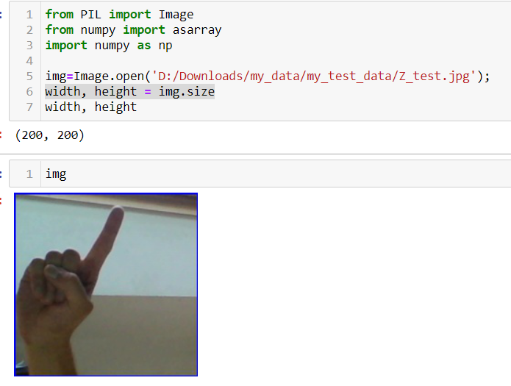
Analysing the Data
Each image is of size (200,200) in rgb color format.

Slide 6
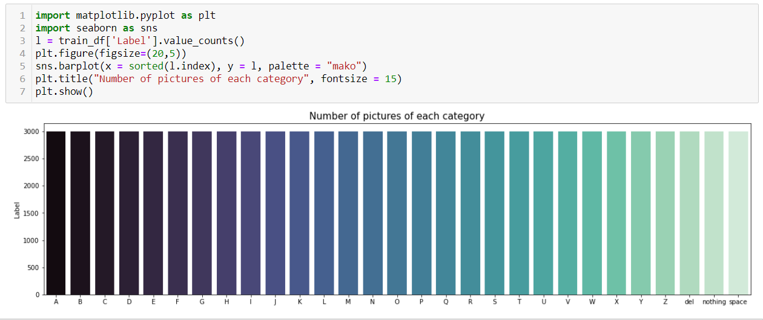
Visualising the Data
Visualizing how the data is distributed in the dataset for better understanding.

Slide 7
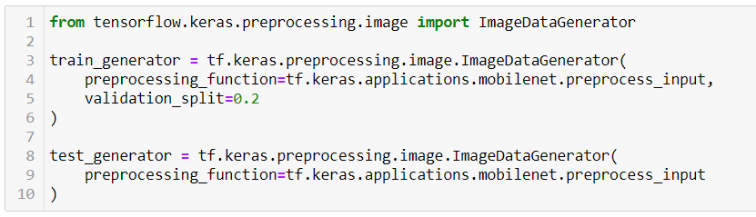
Data Pre-processing
There is no scope in the dataset to have any missing values or an extra column.
Since we have the image directory as our dataset, we will be using data-generators to access our images for training.
As per requirements for our model, we will now resize our images to (224,224), convert it to numpy array and divide it by 255 for encoding.

Slide 8
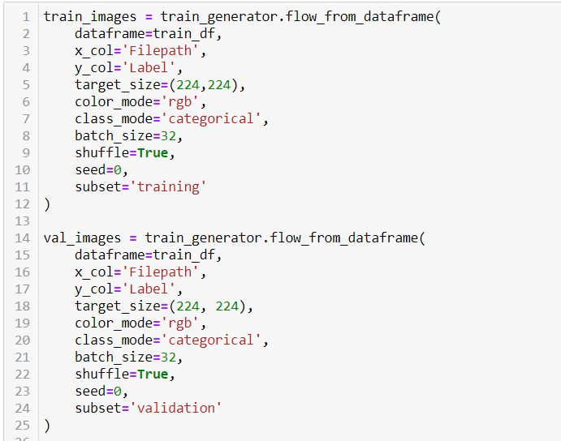

Slide 9
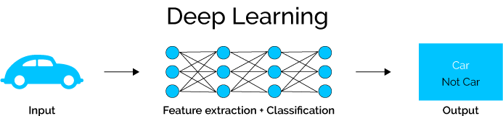
Convolutional Neural Network
Model Selection
Convolutional Neural Network is a class of deep neural network that is used for Computer Vision or analyzing visual imagery.
Computers read images as pixels and it is expressed as a matrix (NxNx3) — (height by width by depth). Images make use of three channels (RGB), so that is why we have a depth of 3.
The Convolutional Layer makes use of a set of learnable filters. A filter is used to detect the presence of specific features or patterns present in the original image (input).

Slide 10
Hard Work or Smart Work?
While working on an edge service we always aim towards developing a mobile application which is scalable and offers the best performance.
When we go towards implementing a ml model inside a mobile device, we must take care of things such as the time a model takes to load in our device and the size it occupies on device’s disk.
For this ml architectures were developed which consists of weights pretrained on image net.
MobileNet is a streamlined architecture that uses depth wise separable convolutions to construct lightweight deep convolutional neural networks and provides an efficient model for mobile and embedded vision applications

Slide 11
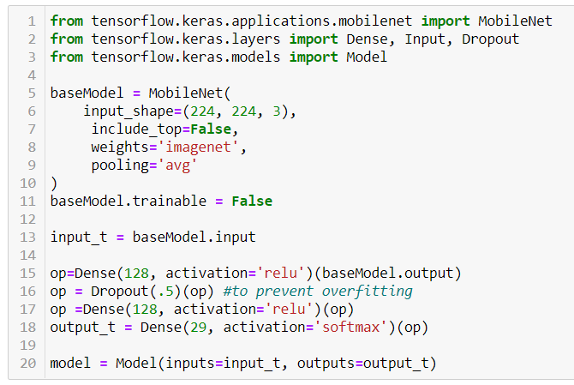
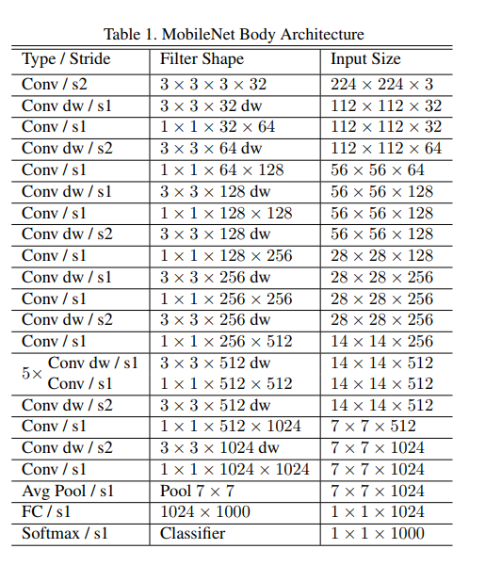
Model building and training
We load the mobilenet from keras and define the input shape

Slide 12
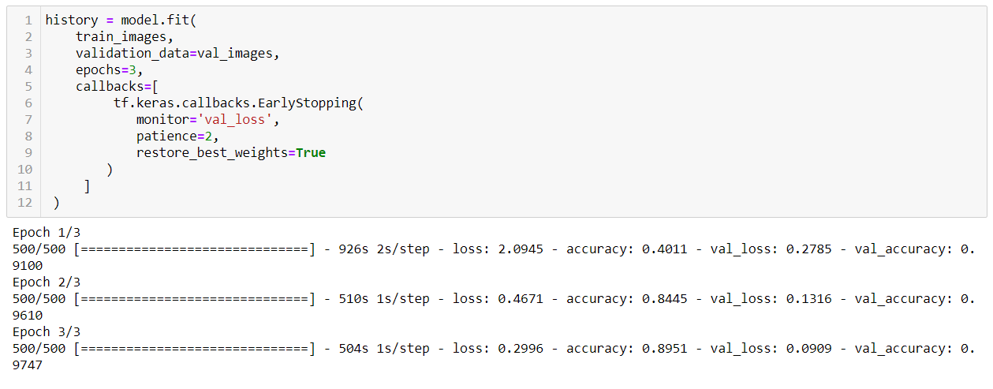
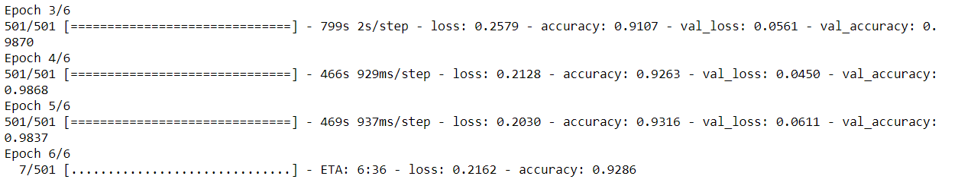
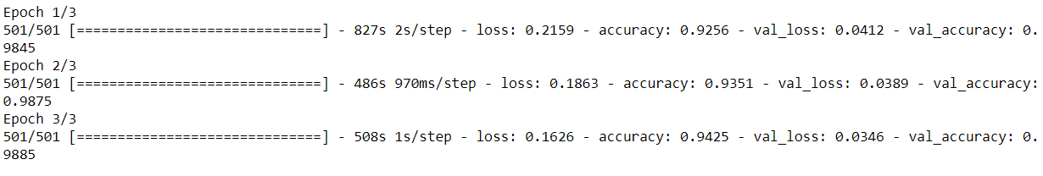
Results
Since the dataset was 84000 images big, I decided to train only 20000 images at once
1st Batch
2nd Batch
3rd Batch

Slide 13
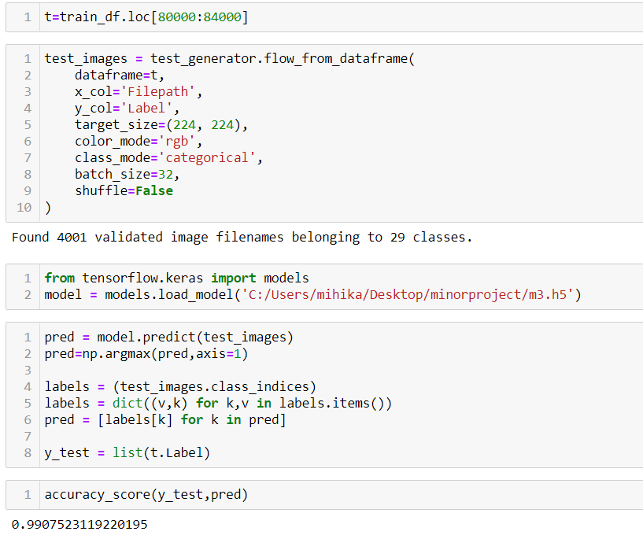
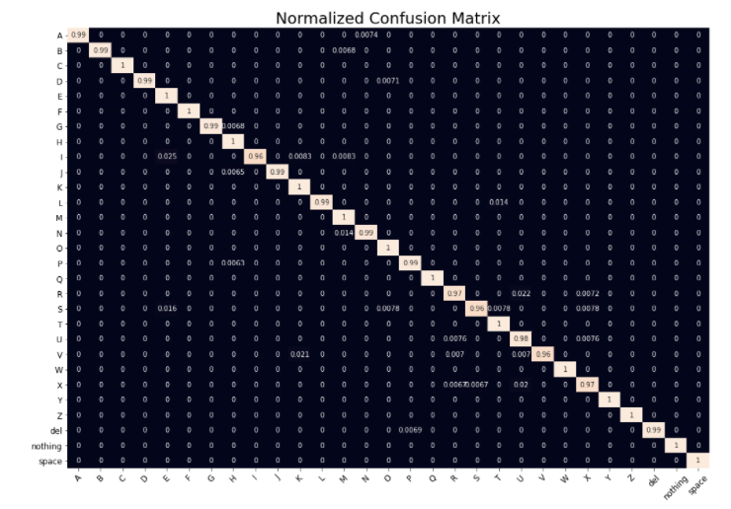
After 3rd batch, I tested its accuracy on the test dataset which was a snippet from the given set with 4000 images

Slide 14

2nd Phase
In the next part of the project, I created a flutter application which uses this TensorFlow model in its backend

Slide 15
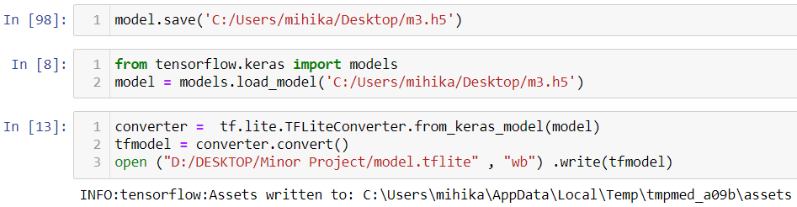
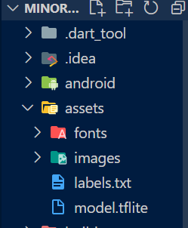
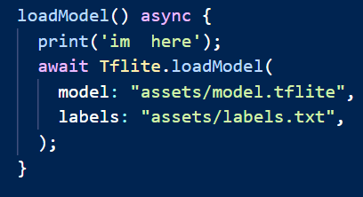
1st we must save the model and convert it into tflite file
Now we create a flutter project and create an assets folder to save our file. Then we create a function to load our model.

Slide 16
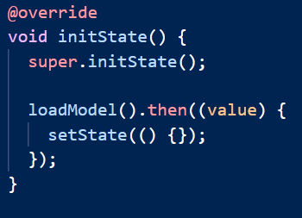
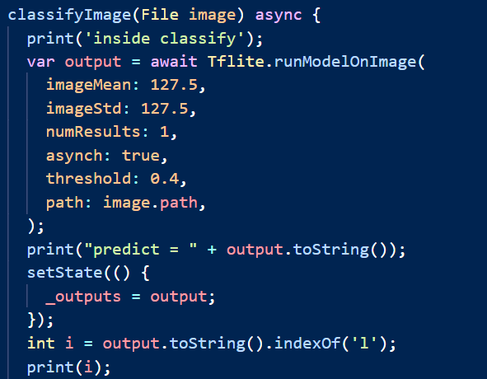
We call our load_model function in init State function so that on the startup of the app, our model loads itself in the memory of app lifecycle.
We then also create our helper widgets which lets us click an image and pick image from our device.
We then feed our image selected by the user to classify function. Remember to preprocess it using the tflite flutter plugin

Slide 17
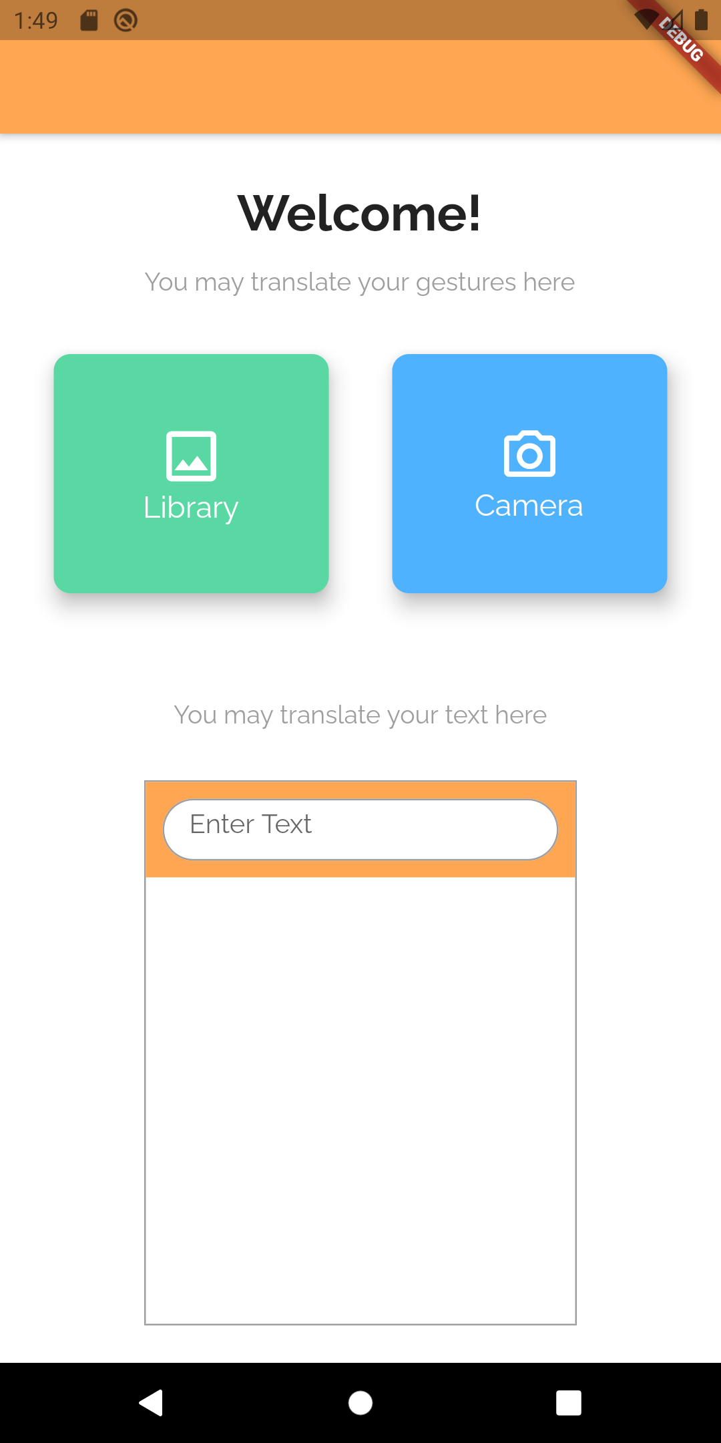
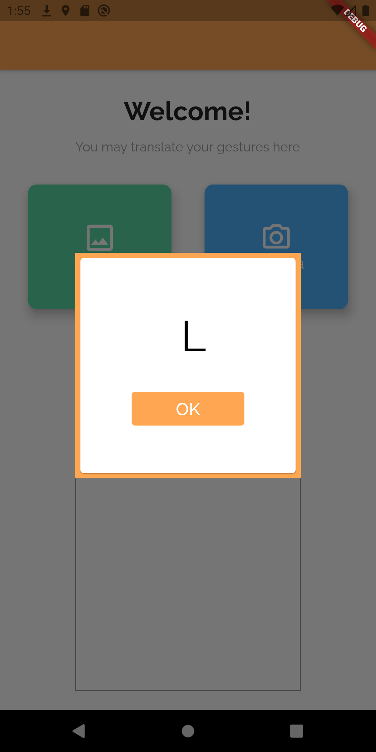
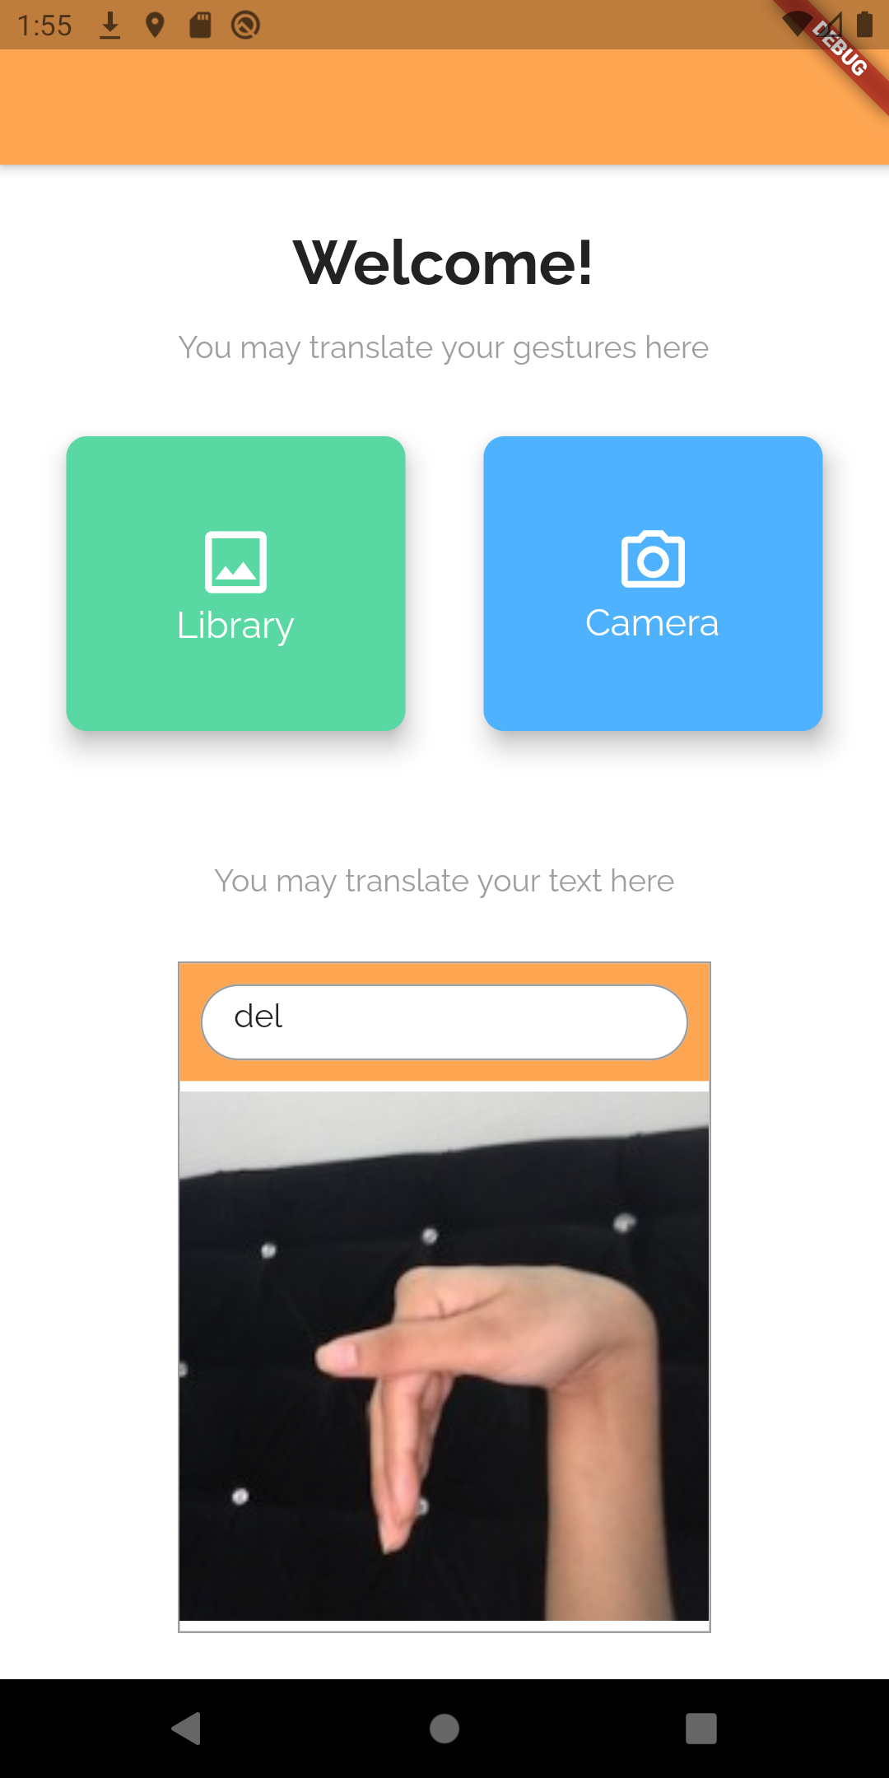
Screenshots from application:

Slide 18
Thankyou

